Slide 1


7.Communication
DR.Somsin THongkrairat

Slide 2
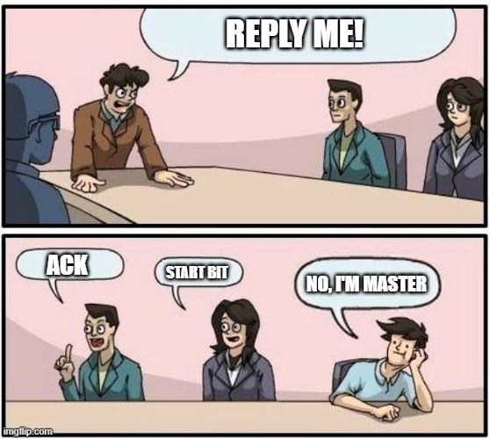

Slide 3
Connectivity
When two or more MCU are in the same system.
Communication are need!

Slide 4
Simplest communication
Send 1 bit or 1 state at a time (GPIO)
GPIOA 12
GPIOC 5

Slide 5
Type of communication
Categorize by direction
Simplex
Half duplex
Full duplex
Categorize by topology
Master-slave
One-to-one
broadcast
Categorize by Clock
Synchronous (Time base)
Asynchronous (clock base)
LAN
GSP
UART
USART
SPI
I2C
One-wire-Serial
?

Slide 6
Categorize by direction
Simplex -> ส่งข้อมูลทางเดียว ไม่สามารถส่งข้อมูลกลับได้
Full duplex -> ส่งข้อไปกลับพร้อมกันได้
Half duplex -> ส่งข้อไปกลับ แต่ทำพร้อมกันไม่ได้
A
B
A
B
A
B
Simplex
Half-Duplex
Full-Duplex

Slide 7
Categorize by topology
One-to-one -> only 2 MCU in network
Master-slave -> Master device control communication BUS
BUS -> every device do same behavior
A
B
M
S1
S2
S3
A
B
C
One to One
Master slave
BUS

Slide 8
Categorize by Clock
Synchronous (Time base) -> speed define by time (pre-define)
Asynchronous (clock base) -> speed define by clock signal (data send with clock signal)
Clock
A
9600 data per sec
B
A
B
data
data
Asynchronous
Synchronous

Slide 9
STM availability
Serial -> UART -> Asynchronous , FULL-Duplex
SPI -> USART -> Synchronous , Master slave, Half-Duplex
I2C -> Two Wire -> Synchronous , Master slave , Full-Duplex
CAN -> CAN interface -> Asynchronous , BUS, Half-Duplex
UCPD -> Asynchronized
ETH -> LAN

Slide 10
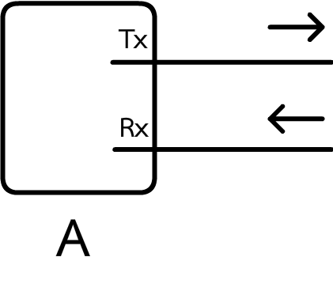
Serial communication
send serial data through media directory
‘H’ -> 0b01001000 (MSB)
Tx = Transmitter (ตัวส่ง)
Rx = Receiver (ตัวรับ)

Slide 11
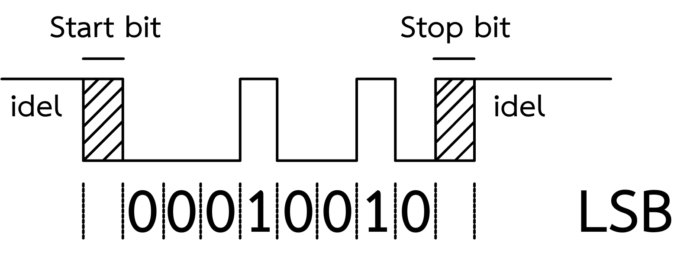
Serial communication data
LSB (less significant bit first) format (Default)
Start bit -> start signal to receive incoming data (logic 0 by default)
Stop bit -> mark end of 1 data (e.g., end of byte) (logic 1 by default)
Parity bit -> check sum (transmit error checking)

Slide 12
‘H’ -> 0b01001000 (MSB)

Slide 13
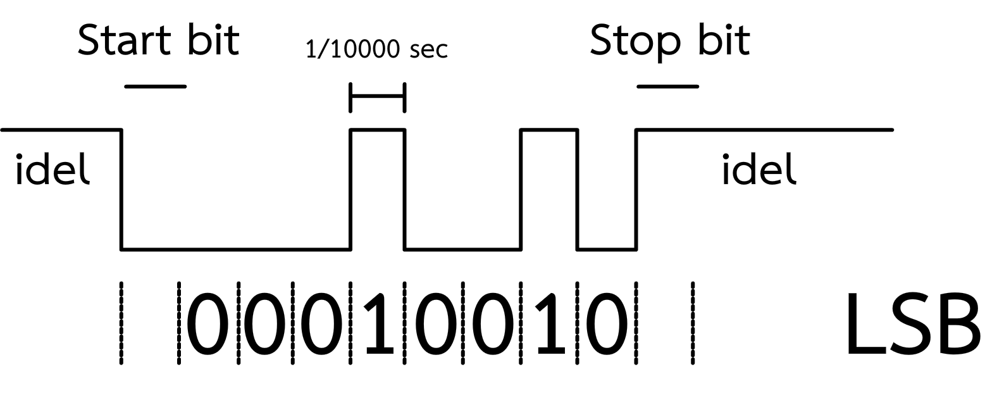
Serial communication
‘H’ -> 0b01001000 (MSB)
Baud rate = 10000 bps, Start bit = 1 baud, Stop bit = 1 baud

Slide 14
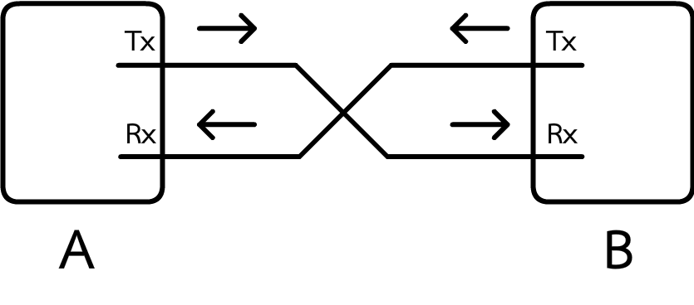
UART
Full duplex , One-to-one , Asynchronous
Rx connect to Tx
Tx connect to Rx
Same baud rate

Slide 15
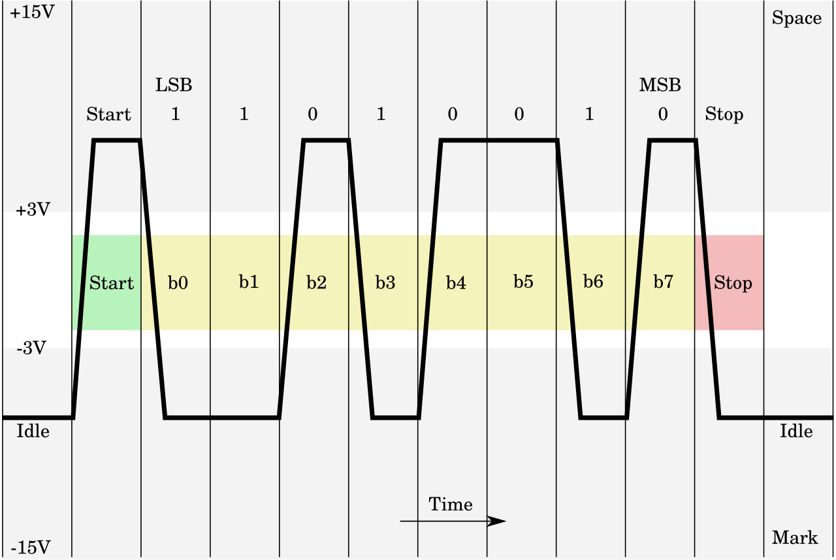
Serial (UART) variant
RS232 -> convert logic level to positive and negative (-5V -> 1 , 5V -> 0) or (-15V -> 1 , 15V -> 0)
Improve robustness (longer and faster)
https://en.wikipedia.org/wiki/RS-232#/media/File:Rs232_oscilloscope_trace.svg

Slide 16
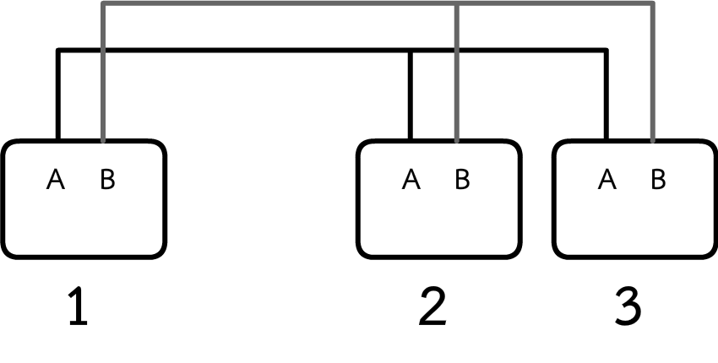
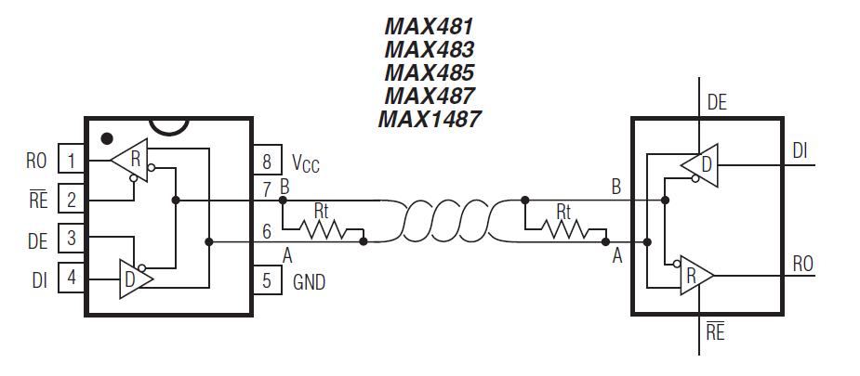
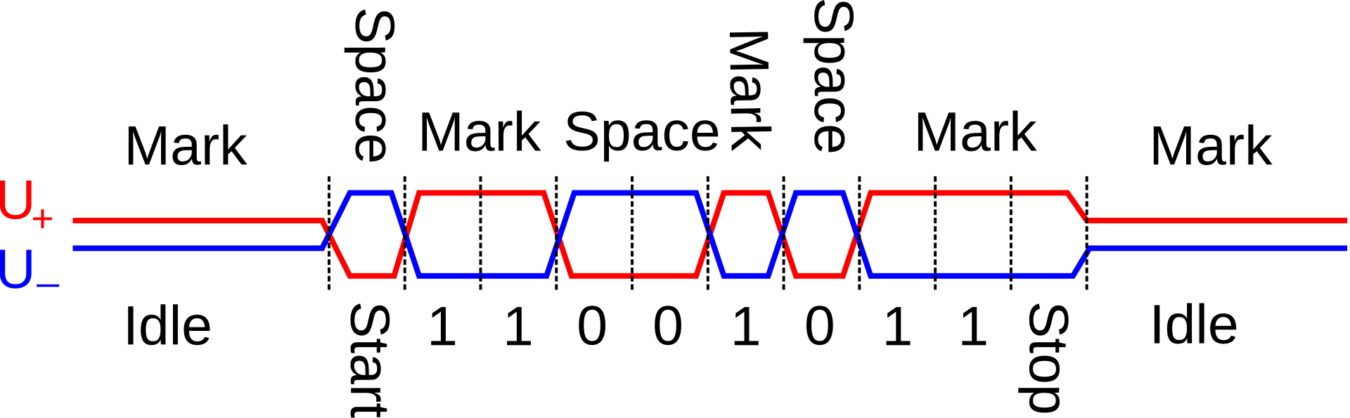
Serial (UART) variant
RS485-> using differential logic () but Half duplex , BUS
https://en.wikipedia.org/wiki/RS-485#/media/File:RS-485_waveform.svg
*MAX485 datasheet

Slide 17
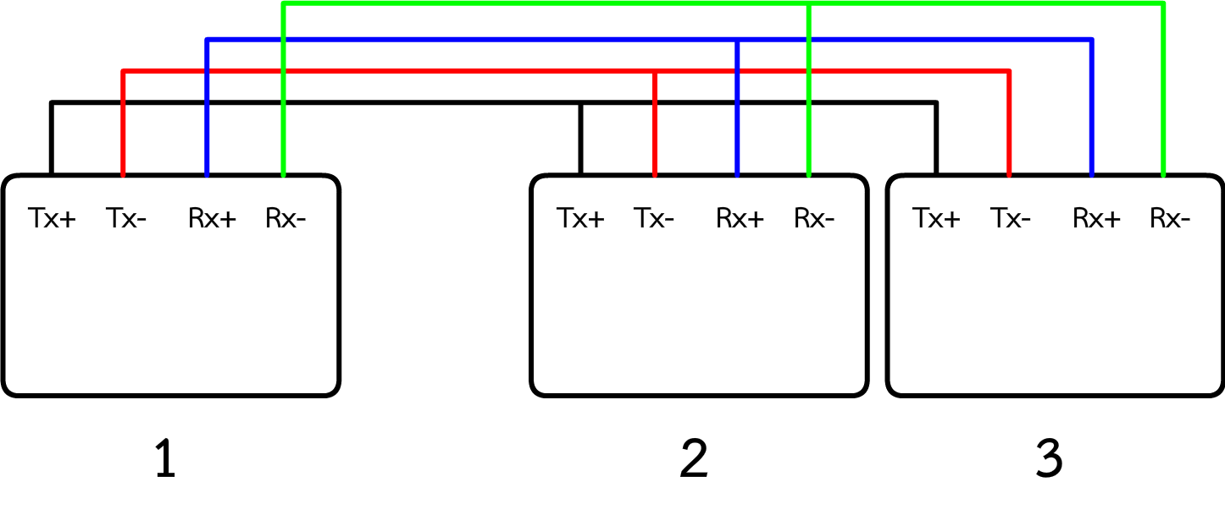
Serial (UART) variant
RS422-> Full duplex version of RS485 (add 1 pair of wire)
https://en.wikipedia.org/wiki/RS-485#/media/File:RS-485_waveform.svg
*MAX485 datasheet

Slide 18
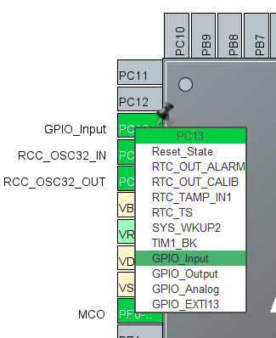
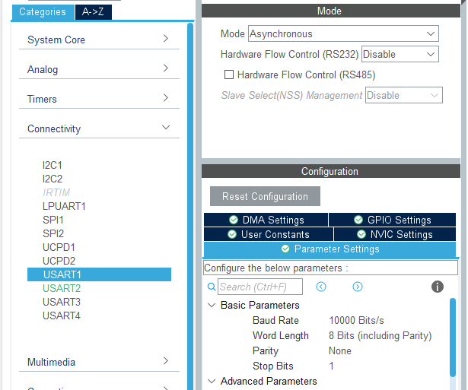
Communication programming sender
Sender is easy because device can send when every they want! (LAB1)
Set PC 13 to Input
Setup USART 1 in Asynchronous mode
Set baud rate to 10000 Bps (8bit)

Slide 19
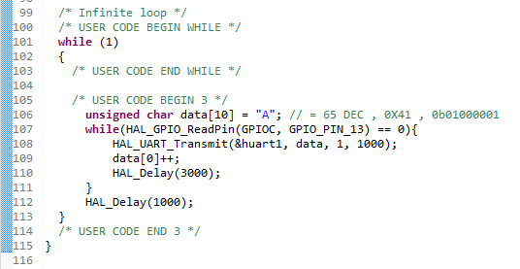
LAB1
/* USER CODE BEGIN 3 */
unsigned char data[10] = "A"; // = 65 DEC , 0X41 , 0b01000001
while(HAL_GPIO_ReadPin(GPIOC, GPIO_PIN_13) == 0){
HAL_UART_Transmit(&huart1, data, 1, 1000);
data[0]++;
HAL_Delay(3000);
}
HAL_Delay(1000);
}
/* USER CODE END 3 */
Send data when button pressed and increase data 1 when hold button

Slide 20
Seeing the data
Measure data using Oscilloscope
USART1 TX -> PC4 (D1 Arduino)
Then hold button
Oscilloscope
PC4 (D1 Arduino)

Slide 21
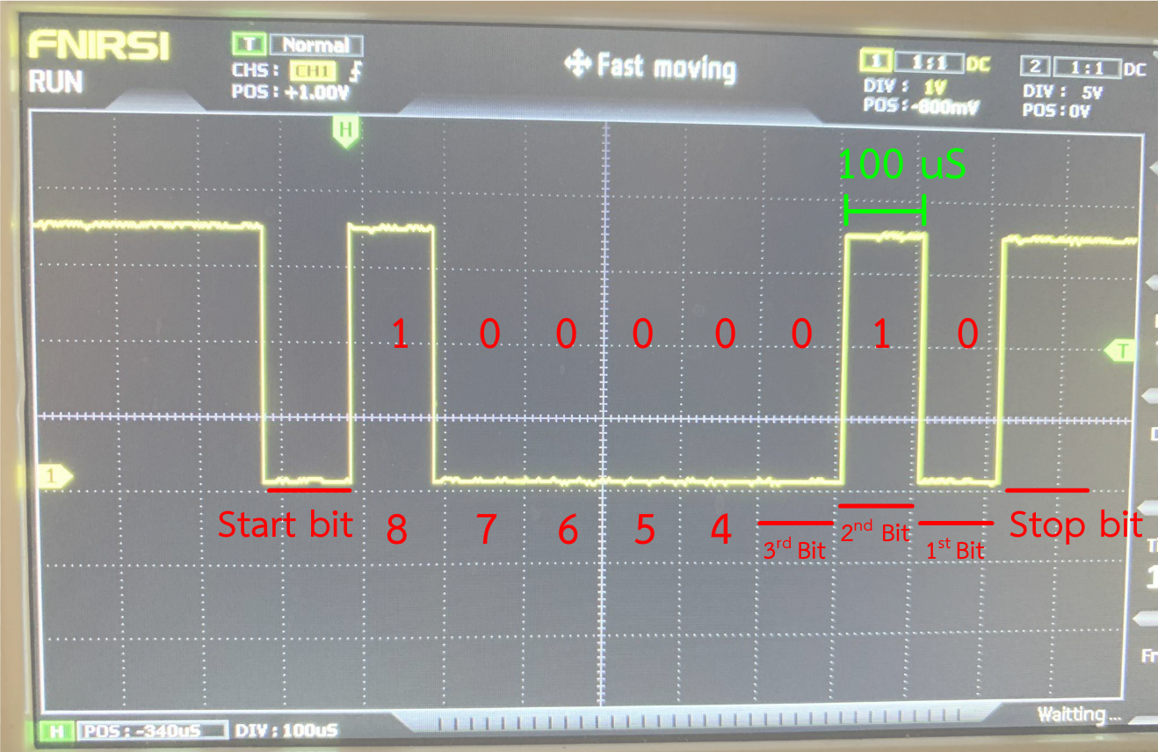

Slide 22
Serial Receiver
*Don’t forget to connect GND
Sender is easy because device can send when every they want! (LAB1)
Receive is more complex because ,We don’t know when the data will come. (LAB2)
Setup USART 1 in Asynchronous mode
Set baud rate to 10000 Bps (8bit)
GND
GND
PC4 (D1)
PC5 (D0)
Sender
Receiver

Slide 23
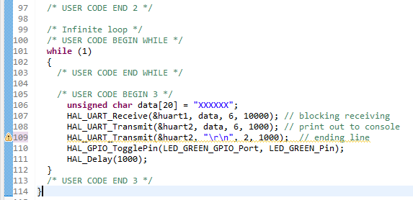
Lab 2 coding
/* USER CODE BEGIN 3 */
unsigned char data[20] = "XXXXXX";
HAL_UART_Receive(&huart1, data, 6, 10000); // blocking receiving
HAL_UART_Transmit(&huart2, data, 6, 1000); // print out to console
HAL_UART_Transmit(&huart2, "\r\n", 2, 1000); // ending line
HAL_GPIO_TogglePin(LED_GREEN_GPIO_Port, LED_GREEN_Pin);
HAL_Delay(1000);
}
/* USER CODE END 3 */

Slide 24
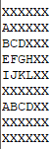
LAB2 blocking mode
Wait 10 sec every display
Wait 10 sec or got data more then 6 byte
Print data

Slide 25
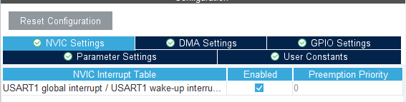
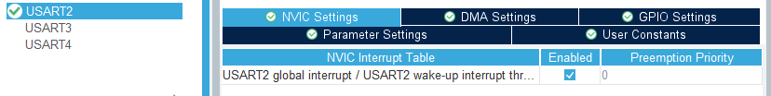
LAB 3 interrupt mode
Setup USART 1 in Asynchronous mode
Set baud rate to 10000 Bps (8bit)
Enable interrupt (both USART1 AND USART2)

Slide 26
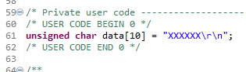
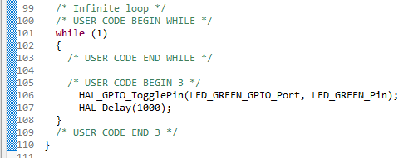
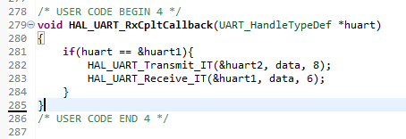
LAB 3 interrupt mode
/* USER CODE BEGIN 0 */
unsigned char data[10] = "XXXXXX\r\n";
/* USER CODE END 0 */
/* Infinite loop */
/* USER CODE BEGIN WHILE */
while (1)
{
/* USER CODE END WHILE */
/* USER CODE BEGIN 3 */
HAL_GPIO_TogglePin(LED_GREEN_GPIO_Port, LED_GREEN_Pin);
HAL_Delay(1000);
}
/* USER CODE END 3 */
/* USER CODE BEGIN 4 */
void HAL_UART_RxCpltCallback(UART_HandleTypeDef *huart)
{
if(huart == &huart1){
HAL_UART_Transmit_IT(&huart2, data, 8);
HAL_UART_Receive_IT(&huart1, data, 6);
}
}
/* USER CODE END 4 */

Slide 27
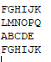
LAB 3 interrupt mode
void HAL_UART_RxCpltCallback(UART_HandleTypeDef *huart)
{
}
Called when received all byte
Non - blocking

Slide 28
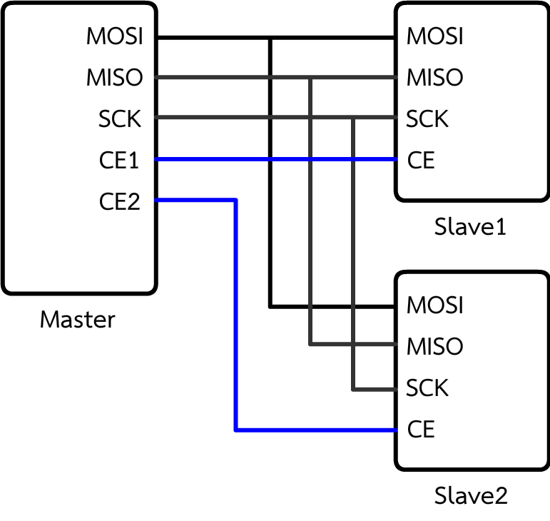
SPI
Serial but Synchronous and Master – Slave topology.
MOSI -> Master out SLAVE in
MISO -> MASTER in SLAVE out
SCK -> Clock signal from MASTER
CE -> chip select (select chip to communicate)

Slide 29
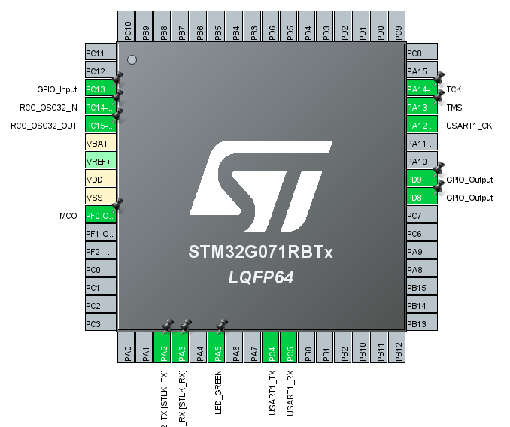
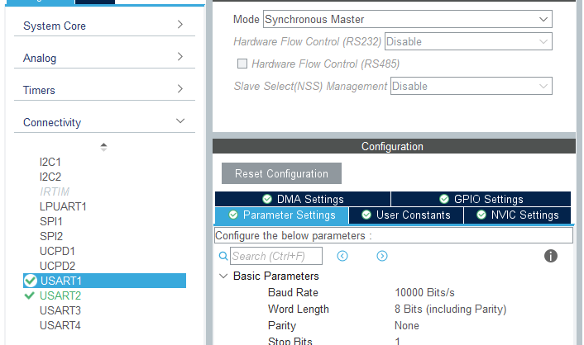
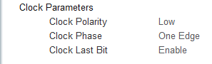
LAB4 SPI (MASTER)
Set USART1 to Synchronous Master (10000 bps) , Enable Clock Last bit
Set PD9,PD8 to GPIO output ,PC13 to input

Slide 30
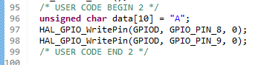
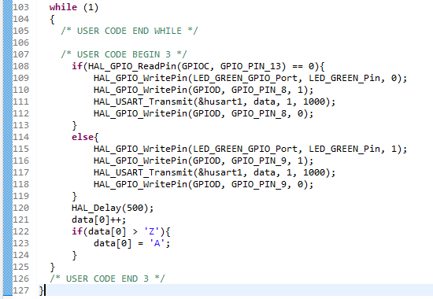
LAB4 SPI (MASTER)
/* USER CODE BEGIN 2 */
unsigned char data[10] = "A";
HAL_GPIO_WritePin(GPIOD, GPIO_PIN_8, 0);
HAL_GPIO_WritePin(GPIOD, GPIO_PIN_9, 0);
/* USER CODE END 2 */
/* Infinite loop */
/* USER CODE BEGIN WHILE */
while (1)
{
/* USER CODE END WHILE */
/* USER CODE BEGIN 3 */
if(HAL_GPIO_ReadPin(GPIOC, GPIO_PIN_13) == 0){
HAL_GPIO_WritePin(LED_GREEN_GPIO_Port, LED_GREEN_Pin, 0);
HAL_GPIO_WritePin(GPIOD, GPIO_PIN_8, 1);
HAL_USART_Transmit(&husart1, data, 1, 1000);
HAL_GPIO_WritePin(GPIOD, GPIO_PIN_8, 0);
}
else{
HAL_GPIO_WritePin(LED_GREEN_GPIO_Port, LED_GREEN_Pin, 1);
HAL_GPIO_WritePin(GPIOD, GPIO_PIN_9, 1);
HAL_USART_Transmit(&husart1, data, 1, 1000);
HAL_GPIO_WritePin(GPIOD, GPIO_PIN_9, 0);
}
HAL_Delay(500);
data[0]++;
if(data[0] > 'Z'){
data[0] = 'A';
}
}
/* USER CODE END 3 */

Slide 31
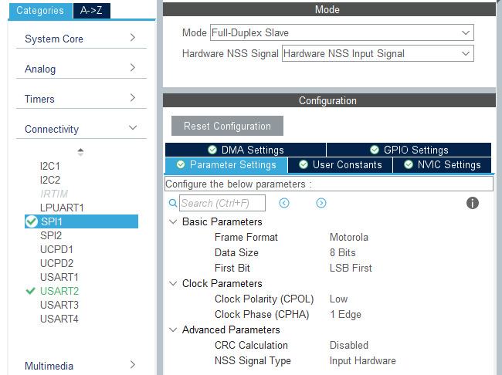
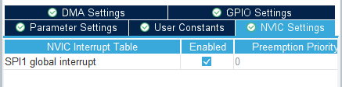
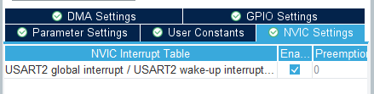
LAB5 SPI (Slave)
Set SPI1 to Full-Duplex Slave
Set 8 bit LSB
Enable SPI1 and UART2 Interrupt
*not necessary to assign baud rate why?

Slide 32
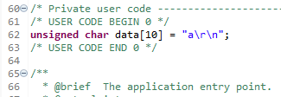
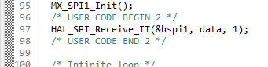
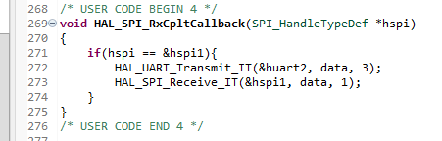
LAB5 SPI (Slave)
/* USER CODE BEGIN 0 */
unsigned char data[10] = "a\r\n";
/* USER CODE END 0 */
/* USER CODE BEGIN 2 */
HAL_SPI_Receive_IT(&hspi1, data, 1);
/* USER CODE END 2 */
/* USER CODE BEGIN 4 */
void HAL_SPI_RxCpltCallback(SPI_HandleTypeDef *hspi)
{
if(hspi == &hspi1){
HAL_UART_Transmit_IT(&huart2, data, 3);
HAL_SPI_Receive_IT(&hspi1, data, 1);
}
}
/* USER CODE END 4 */

Slide 33
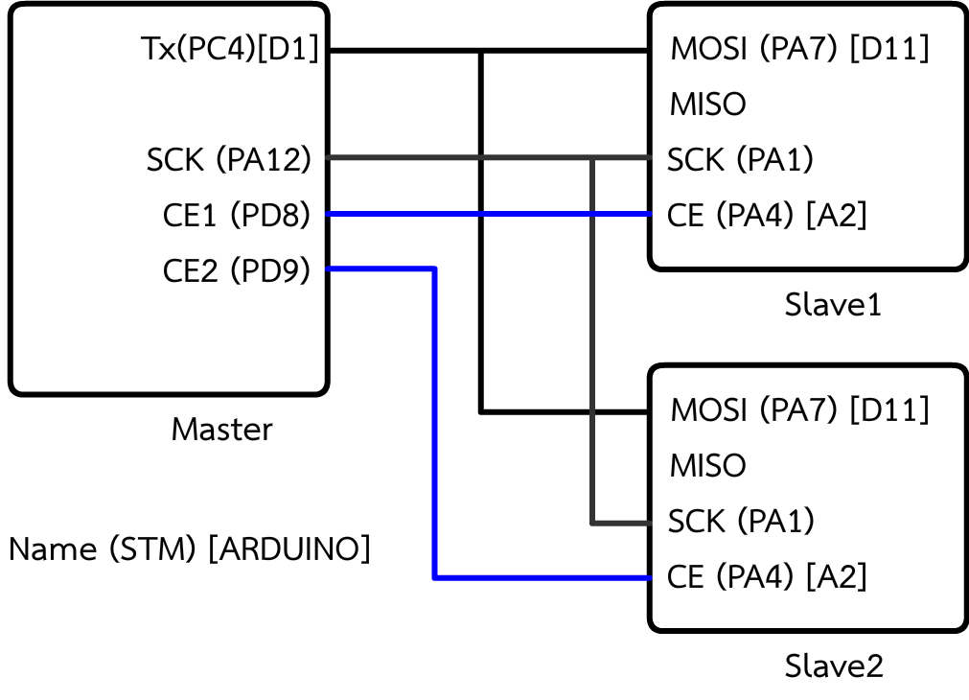
LAB 4 & 5 Topology
Baud rate is defined by master

Slide 34
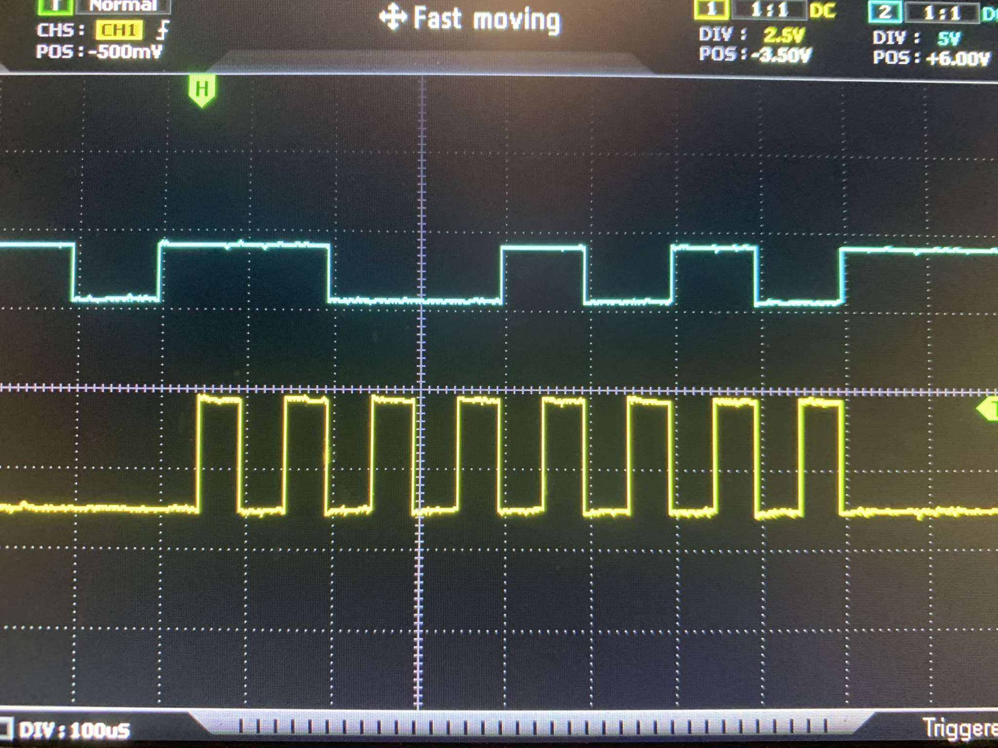

Slide 35
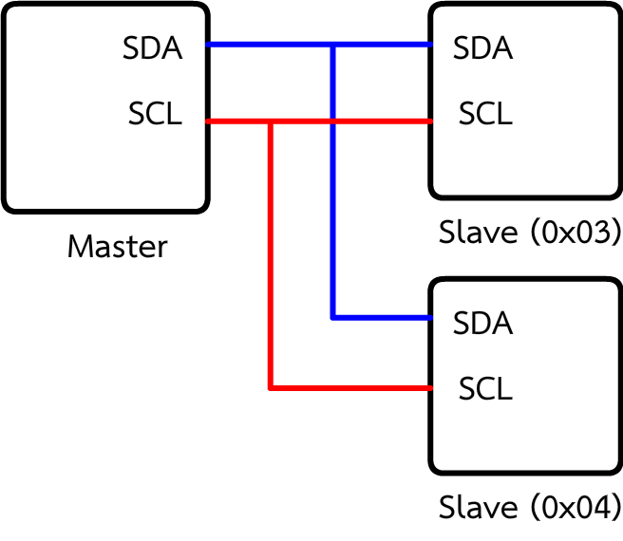
I2C
SPI but use address in communication to select chip (use only 2 wire)
SDA -> DATA
SCL -> CLOCK
Address was assigned to every device except master
Select slave by address

Slide 36
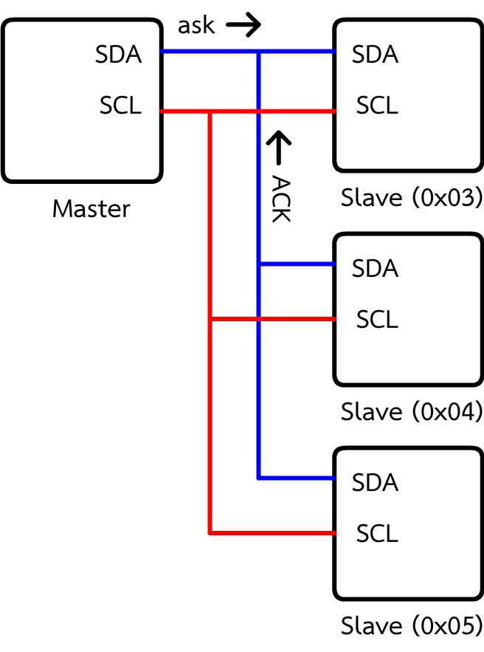
I2C
Connect start by master ask for device xx
If there are device address xx , device will send ACK back to BUS
ACK = acknowledgement = สัญญาณตอบกลับ
NACK = negative-acknowledgement = สัญญาณตอบกลับแบบลบ

Slide 37
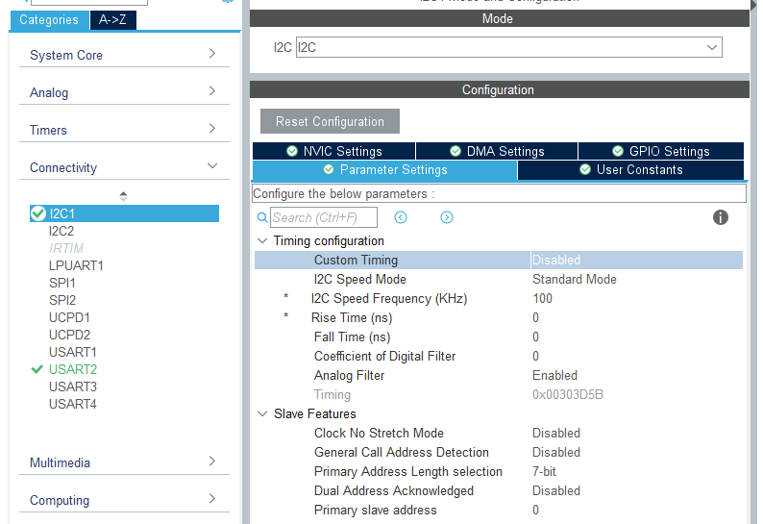
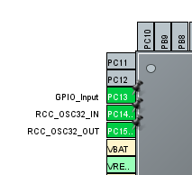
LAB 6 I2C (MASTER)
Enable I2C set standard frequency 100000 Hz
Set address to 0 (MASTER)
Set PC13 to Input

Slide 38
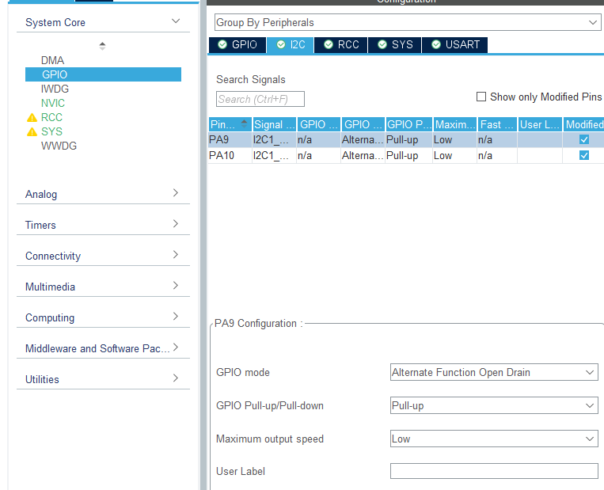
LAB 6 I2C (MASTER)
Set pullup PA9(SCL) , PA10(SDA)

Slide 39
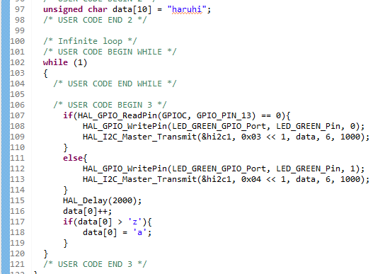
LAB 6 I2C (MASTER)
/* USER CODE BEGIN 2 */
unsigned char data[10] = "haruhi";
/* USER CODE END 2 */
/* Infinite loop */
/* USER CODE BEGIN WHILE */
while (1)
{
/* USER CODE END WHILE */
/* USER CODE BEGIN 3 */
if(HAL_GPIO_ReadPin(GPIOC, GPIO_PIN_13) == 0){
HAL_GPIO_WritePin(LED_GREEN_GPIO_Port, LED_GREEN_Pin, 0);
HAL_I2C_Master_Transmit(&hi2c1, 0x03 << 1, data, 6, 1000);
}
else{
HAL_GPIO_WritePin(LED_GREEN_GPIO_Port, LED_GREEN_Pin, 1);
HAL_I2C_Master_Transmit(&hi2c1, 0x04 << 1, data, 6, 1000);
}
HAL_Delay(2000);
data[0]++;
if(data[0] > 'z'){
data[0] = 'a';
}
}
/* USER CODE END 3 */

Slide 40
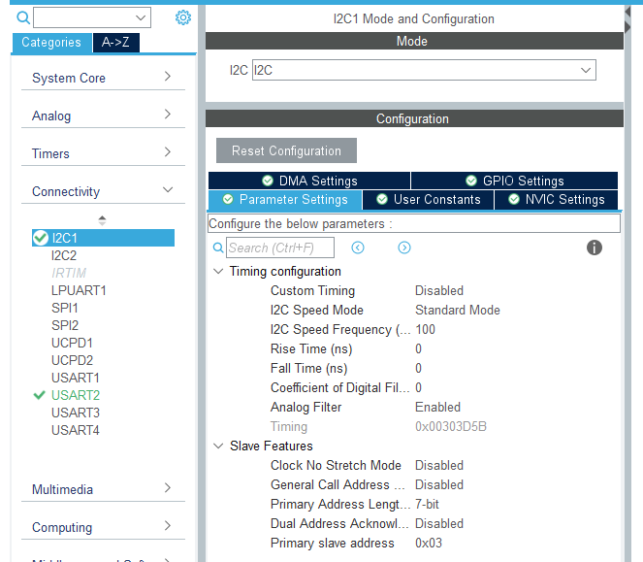
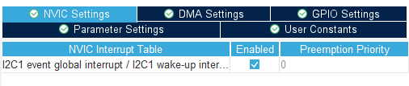
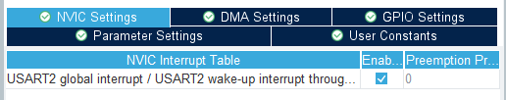
LAB 7 I2C Slave
Enable I2C set standard frequency 100000 Hz
Set address to 0x03 and 0x04
Enable I2C1 and UART2 interrupt

Slide 41
LAB 7 I2C Slave
Set pullup PA9(SCL) , PA10(SDA)

Slide 42
LAB 7 I2C Slave
/* USER CODE BEGIN 4 */
void HAL_I2C_ListenCpltCallback (I2C_HandleTypeDef *hi2c)
{
HAL_I2C_EnableListen_IT(hi2c);
}
extern void HAL_I2C_AddrCallback(I2C_HandleTypeDef *hi2c, uint8_t TransferDirection, uint16_t AddrMatchCode)
{
if(TransferDirection == I2C_DIRECTION_TRANSMIT) // if the master wants to transmit the data
{
HAL_I2C_Slave_Sequential_Receive_IT(hi2c, data, 6, I2C_FIRST_AND_LAST_FRAME);
}
else // master requesting the data is not supported yet
{
Error_Handler();
}
}
void HAL_I2C_SlaveRxCpltCallback(I2C_HandleTypeDef *hi2c)
{
if(hi2c == &hi2c1){
HAL_UART_Transmit_IT(&huart2, data, 6);
}
}
void HAL_I2C_ErrorCallback(I2C_HandleTypeDef *hi2c)
{
HAL_I2C_EnableListen_IT(hi2c);
}
/* USER CODE END 4 */
/* USER CODE BEGIN 0 */
unsigned char data[10] = "A\r\n";
/* USER CODE END 0 */
/* USER CODE BEGIN 2 */
HAL_I2C_EnableListen_IT(&hi2c1);
/* USER CODE END 2 */

Slide 43
I2C topology

Slide 44
